Slide 1
Police Executive Leadership College
Successful Strategies
…for writing PELC related papers and assignments
Prepared by: Chief Jeffrey K. Scott, MBA, CLEE
Evaluator/ Grader for PELC Paper Assignments

Slide 2


PELC Paper Grader/Evaluator
Chief Jeffrey Scott, CLEE
Notre Dame College Police, South Euclid
jscott@ndc.edu

Slide 3
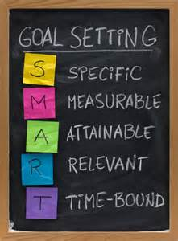
Goals
Focused Writing and Research
Foundational Work and Outlines
Sources and Data Gathering
Outline to Draft
Proofread and Polish
Final Product…Check your work
APA Format
Grammar and Punctuation (comma’s)
Common Errors and final thoughts

Slide 4

Focused Writing and Research
Research is a “Process”
Seeking answers and supporting theories
You must first draft the ‘question’
Then seek materials to ‘support’ your answer
Credible
Specific
Focused
Relevant
Current

Slide 5

Foundational Work and Outlines
Lay the Foundation
Read the INSTRUCTIONS for your assignment
Read the materials provided for you
Assigned Books
Assigned Articles
Finding other related source support material
Take notes
Highlight
Post-its
Tabs
Write down initial thoughts or opinions
Develop a preliminary thesis

Slide 6
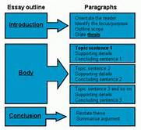
Foundational Work and Outlines
Begin to Outline your paper
Introductory Statement
Points out the main themes you will cover
Brief snap-shot of your main body
Main Body
Specific
Identifies: describes the issues
Offers solutions, thoughts, or ideas
Expands
Critical Thinking
Is supported by readings or scholarly references
Multiple sources

Slide 7
Foundational Work and Outlines
Begin to Outline your paper…(continued)
Conclusion
Re-cap of Main Ideas, thoughts and discussion
Brief and succinct
Emphasis on most critical thoughts and analysis
References
Develop key scholarly documents
Use online tools for proper APA formatting

Slide 8
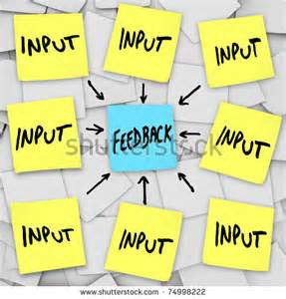
Sources and Data Gathering
Gather your data
Brainstorm about your sources
Journals and periodicals (industry specific to law enforcement)
Police Magazine
Law Officer Magazine
www.ForceScience.org
Assigned Readings
Books
Articles

Slide 9
Sources and Data Gathering
Ensure information is RELEVANT to the topic
Stay focused
Avoid ‘filler’ or ‘fluff’ just to make it look good or meet the length requirement
Take notes
Helps you avoid wasting time
REMEMBER TO CITE the Author or reference
PLAGIARISM (properly cite others’ work)
You are LE Officers…Maintain INTEGRITY

Slide 10

Outline… to… Draft Paper
Review your materials and notes
Develop an ‘IDEA ROAD MAP’
Place notes in order
Add quotes, avoid plagiarism
Articulate an informed opinion
BE SPECIFIC, narrowed in scope
Avoid being too vague or broad stroked
Back up your thoughts with scholarly support

Slide 11

Outline… to… Draft Paper
Double check you have met ALL requirements for the paper (read the instructions!)
Stay FOCUSED and ORGANIZED
Ask yourself…
“Are any questions left unanswered?”

Slide 12
PROOFREAD and Polish
Pay close attention to the paper’s organization
Have you covered all the required information, based on the assignment requirements page?
Place your thoughts in:
Logical order
Complement your research
Connect everything with effective transitions
Be focused
Avoid ‘being all over the place’ or scattered

Slide 13
PROOFREAD and Polish
Strengthen your introduction and conclusion
Double-check your citations and follow APA
Proper APA format
http://owl.english.purdue.edu/owl
http://www.apastyle.org
Insert parenthetical citations with source page
CORRECT grammatical and mechanical errors
Watch RUN ON sentences and paragraph formations
Review your formatting (standard 1” margin rule)

Slide 14

FINAL PRODUCT – Check your work
Read your paper out loud
Listen to the tone and style
Does it make sense? Is it logical?
Make sure the paper MEETS all the guidelines or requirements

Slide 15

FINAL PRODUCT – Check your work
Ensure proper APA formatting
DEFEND YOUR WORK (citations from scholarly documents)…back up your theories
Have someone else read your work product
Get critiques from others
DO NOT WAIT UNTIL THE LAST MINUTE to do your paper

Slide 16

APA Formatting and Style Guide
General APA Format
Source Reference from website: http://owl.english.purdue.edu/owl
Notes:
Welcome to “APA Formatting and Style Guide”. This Power Point Presentation is designed to introduce your students to the basics of APA Formatting and Style Guide. You might want to supplement the presentation with more detailed information posted on Purdue OWL http://owl.english.purdue.edu/owl/resource/560/01/

Slide 17

The American Psychological Association (APA) citation style is the most commonly used format for manuscripts in the social sciences.
APA regulates:
Stylistics
In-text citations
References
Notes:
Publication Manual of the American Psychological Association, 6th ed., contains detailed guidelines to formatting a paper in the APA style. APA style is most commonly used for formatting papers in the Social Sciences—business, economics, psychology, sociology, nursing, etc. Updates to APA are posted on the APA website www.apastyle.org. You may also reference the Purdue OWL: http://owl.english.purdue.edu/.
APA format provides writers with a format for cross-referencing their sources--from their parenthetical references to their reference page. This cross-referencing system allows readers to locate the publication information of source material. This is of great value for researchers who may want to locate your sources for their own research projects. The proper use of APA style also shows the credibility of writers; such writers show accountability to their source material. Most importantly, use of APA style can protect writers from plagiarism--the purposeful or accidental use of source material by other writers without giving appropriate credit.

Slide 18
Your paper should:
be typed,
be double-spaced,
have 1” margins,
use 12 pt. standard font (ex. Times New Roman, Calibri or Arial), and
be printed on standard-sized paper (8.5”x 11”)
papers will be submitted to PELC Grader as a PDF document
Notes:
This slide presents the general format of an APA formatted paper: An essay should be typed and double-spaced on the standard-sized paper (8.5”x11”) with 1” margins on all sides. Times New Roman or similar font in 10-12 pt. size should be used. The document should include a page header indicating a short title of the essay and a page number in the upper right-hand of every page (including the title page).

Slide 19
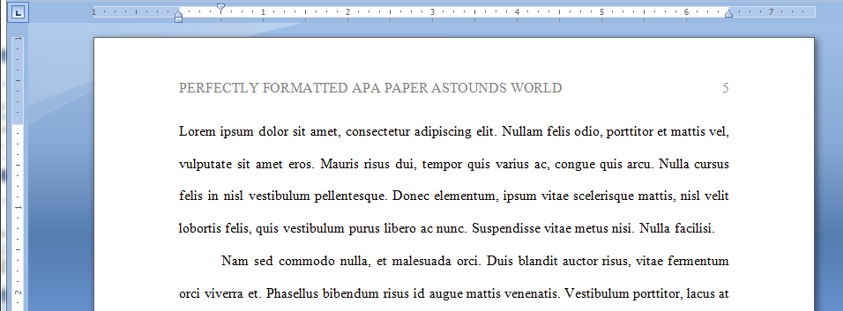
Every page of your paper (including title page) should:
Include a page header (Title, all caps) in the upper left- hand corner and
the page number in the upper right
Notes:
This slide presents the general format of an APA formatted paper: An essay should be typed and double-spaced on the standard-sized paper (8.5”x11”) with 1” margins on all sides. Times New Roman or similar font in 10-12 pt. size should be used. The document should include a page header indicating a short title of the essay and a page number in the upper right-hand of every page (including the title page).

Slide 20
Your PELC paper should
include four major sections:
Title page
Main Body
References
Annotated Bibliography
Notes:
This slide introduces four required part of an APA paper: a title page, abstract, main body (essay itself), and a list of References. An abstract page and list of references are titled as Abstract and Reference, respectively.
It is important to remind students that each page should have a page header with a short title and page number.
This slide can be supplemented by the “General Format” section from OWL http://owl.english.purdue.edu/owl/resource/560/01/

Slide 21
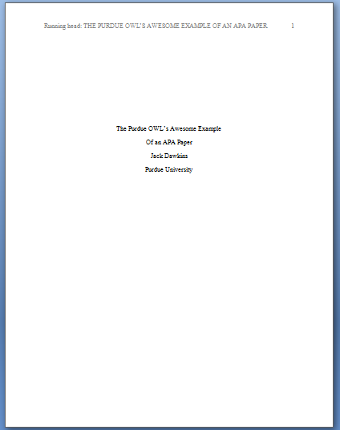
Title Page
Page header:
(use Insert Page Header)
title flush left + page number flush right.
Title:
(in the upper half of the page, centered)
name (no title or degree) + affiliation (university, etc.)

Slide 22
Main Body (Text)
Number the first text page as page number 2
Type and center the title of the paper at the top of the page
Type the text double-spaced with all sections following each other without a break
Identify the sources you use in the paper in parenthetical, in-text citations
Format tables and figures
Notes:
This slide provides the basic reminders about formatting the text:
Make sure that the first text page is page number 3 (page#1 is a title page, page #2 is an abstract page).
Start with typing the essay title centered, at the top of the page.
Type the text double-space with all sections following each other without a break. Do not use white space between paragraphs.
Create parenthetical in-text citations to identify the sources used in the paper.
Format tables and figures.
The following slides introduce APA formatting of references, in-text citations, and tables and figures.

Slide 23
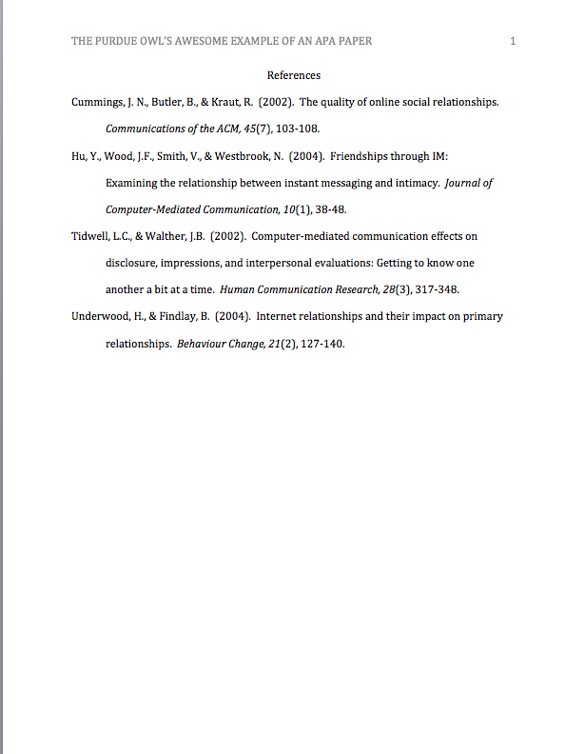
Reference Page
Center the title (References) at the top of the page. Do not bold it.
Double-space reference entries
Flush left the first line of the entry and indent subsequent lines
Order entries alphabetically by the surname of the first author of each work
Notes:
This slide explains the format and purpose of a references page.
The facilitator may stress that each source referenced within the paper should also appear on the reference page, which appears at the end of the paper.
To create a references page,
center the heading—References—at the top of the page;
double-space reference entries;
flush left the first line of the entry and indent subsequent lines. To use “hanging” feature of “Indent and Space” tab, go to “Paragraph” →”Indentation” →choose “Hanging” in the ”Special” box.
Order entries alphabetically by the author’s surnames. If a source is anonymous, use its title as an author’s surname.
Note: Unlike MLA, APA is only interested in what they call “recoverable data”—that is, data which other people can find. For example, personal communications such as letters, memos, emails, interviews, and telephone conversations should not be included in the reference list since they are not recoverable by other researchers.
For specific information about entries in the reference list, go to http://owl.english.purdue.edu/owl/resource/560/05

Slide 24
References: Basics
Invert authors’ names (last name first followed by initials)
EX:“Smith, J.Q.”
Capitalize only the first letter of the first word of a title and subtitle, the first word after a colon or a dash in the title, and proper nouns. Do not capitalize the first letter of the second word in a hyphenated compound word.
EX: The perfectly formatted paper: How the Purdue OWL saved my essay.
Notes:
This slide provides basic rules related to creating references entries.

Slide 25
Making the Reference List
APA is a complex system of citation. When compiling the reference list, the strategy below might be useful:
Identify the type of source:
Is it a book? A journal article? A webpage?
Find a sample citation for this type of source
Check a textbook or the OWL APA Guide: http://owl.english.purdue.edu/owl/resource/560/01/
Notes:
APA is a complex system of citation, which is time-consuming to learn and difficult to keep in mind. To help students handle the requirements of APA format, this slide introduces a strategy of surviving APA.
The facilitator should stress the importance of correct identification of a type of source: e.g., Is it an article from a newspaper or from a scholarly journal? Hard copy or electronic version?
When the source type is identified correctly, it’s fairly easy to find a sample of a similar reference in the APA chapter of a composition book or in an on-line APA resource. The APA guide on the OWL website is particularly easy to browse since its links are organized by types of sources—scroll down to the box of links http://owl.english.purdue.edu/owl/resource/560/01/
After a sample is found, all it takes is to mirror it precisely and arrange entries in the alphabetical order.
Note: Many electronic library databases, e.g. Proquest, have citation feature. The useful strategy is to save and import into a references list citation entries (make sure you choose APA format) while doing literature search. You can always delete later reference entries of the sources you’re not going to use in the paper.

Slide 26
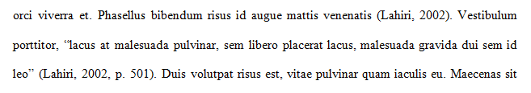
In-text Citation: Basics
In-text citations help readers locate the cited source in the References section of the paper.
Whenever you use a source, provide in parenthesis:
the author’s name and the date of publication
for quotations and close paraphrases, provide the author’s name, date of publication, and a page number
Notes:
This slide explains the basics of in-text citations.
In-text citations help establish credibility of the writer, show respect to someone else’s intellectual property (and consequently, avoid plagiarism). More practically, in-text citations help readers locate the cited source in the references page. Thus, keep the in-text citation brief and make sure that the information provided in the body of the paper should be just enough so that a reader could easily cross-reference the citation with its matching entry on the reference page; i.e., the body of the paper and the in-text citation together contains the author’s name and the year of publication. To avoid plagiarism, also provide a page number (in p.3 / pp.3-5 format) for close paraphrases and quotations.

Slide 27
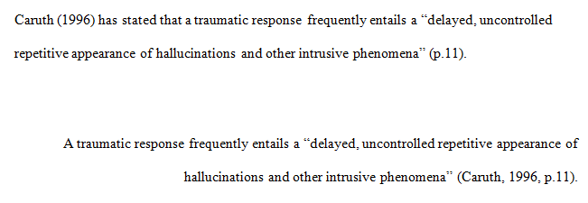
In-Text Citation:
Quotations
When quoting:
Introduce the quotation with a signal phrase
Include the author’s name, year of publication, and page number
Keep the citation brief—do not repeat the information
Notes:
This slide provides explanation and examples of in-text citations with quotations.

Slide 28
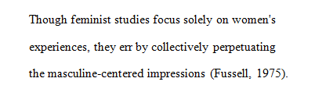
In-Text Citation:
Summary or Paraphrase
Provide the author’s last name and the year of
publication in parenthesis after a summary or a paraphrase.
Notes:
APA format is not limited by the rules of citing the sources- in-text citations and entries in the list of References. It also regulates the stylistics of conveying research.
This slide introduces the basics of APA stylistics related to the point of view and voice in an APA paper, which encourages a writer to use personal pronouns and the active voice. The explanations are provided with examples.
This slide can be supplemented by the relevant section from OWL http://owl.english.purdue.edu/owl/resource/560/15/

Slide 29
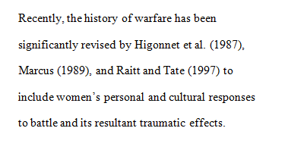
In-Text Citation:
Summary or Paraphrase
Include the author’s name in the signal phrase, followed by the year of publication in parenthesis.
Notes:
The following three slides provide instructions and examples of in-text citations with summary/ paraphrase.
The facilitator should emphasize the importance of developing the skills of critical reading (which enables finding main claims in the text), summarizing, and paraphrasing. When paraphrasing or summarizing, the major concern should be fair and accurate representation of the ideas in the source.
This slide can be supplemented by the “Quoting, Paraphrasing, and Summarizing” section from OWL
http://owl.english.purdue.edu/owl/resource/563/01/
and sections on APA in-text citations:
http://owl.english.purdue.edu/owl/resource/560/01/
http://owl.english.purdue.edu/owl/resource/560/02

Slide 30
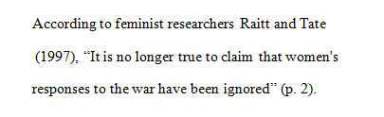
In-Text Citation:
Summary or Paraphrase
When including the quotation in a summary/paraphrase, also provide a page number in parenthesis after the quotation:
Notes:
This slide continues explaining formatting in-text citations with summary/ paraphrase.

Slide 31
In-Text Citation:
Signal Words
Introduce quotations with signal phrases, e.g.:
According to Xavier (2008), “….” (p. 3).
Xavier (2008) argued that “……” (p. 3).
Use such signal verbs such as:
acknowledged, contended, maintained,
responded, reported, argued, concluded, etc.
Use the past tense or the present perfect tense of verbs in signal phrases when they discuss past events.
Notes:
Acquiring a rich repertoire of signal words and phrases is the key to success in representing others’ ideas in academic writing. This slide provides a few examples of those and reminds that APA requires to use the past or present perfect tense of verbs in signal phrases.
The facilitator might want to point to the chapter in the composition book that introduces and practices signal words.

Slide 32

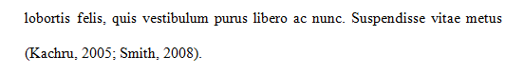
In-Text Citation:
Two or More Works
When the parenthetical citation includes two or
more works, order them in the same way they appear in the reference list—the author’s name, the year of publication—separated by a semi-colon.
Notes:
This slide explains and exemplifies the specific cases of in-text citations. It might be supplemented with “Author/Authors” section from OWL http://owl.english.purdue.edu/owl/resource/560/03/

Slide 33
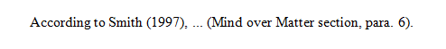
In-Text Citation:
Electronic Sources
When citing an electronic document, whenever possible, cite it in the author-date style. If electronic source lacks page numbers, locate and identify paragraph number/paragraph heading.
Notes:
This slide explains and exemplifies the specific cases of in-text citations. It might be supplemented with “Author/Authors” section from OWL http://owl.english.purdue.edu/owl/resource/560/03/

Slide 34
Additional Resources
The Purdue OWL: http://owl.english.purdue.edu
Composition textbooks
Publication Manual of the American Psychological Association, 6th ed.
APA’s website: http://www.apastyle.org
Notes:
There are many rules for following APA format, and the facilitator should stress that it is nearly impossible to memorize them all. Students’ best course of action is to utilize the official APA handbook or the APA section in an updated composition textbook as guides for properly using the documentation format. Since the American Psychological Association, a professional group of behavioral and social science professors and instructors, periodically updates the guide, students should be certain that they are using the most current information possible.
There are other resources for finding current information on APA documentation style. The APA web site offers some limited information about recent format changes, especially regarding the documentation of World Wide Web and electronic sources. The Purdue University Writing Lab has a page on APA formatting and documentation style at its web site: http://owl.english.purdue.edu/owl/resource/560/01/ For quick questions on APA format, students can also call the Writing Lab Grammar Hotline at 494-3723.

Slide 35

Conquering the Comma
Source Reference from website: http://owl.english.purdue.edu/owl
Notes:
Rationale: Welcome to “Conquering the Comma.” This presentation is designed to acquaint your students with the rules of comma usage, including placement in compound sentences, after introductory elements, with dependent phrases and clauses, around nonessential elements, in a series, and with adjectives. This presentation will also cover methods for avoiding a common comma error—the comma splice. The thirty-one slide presented here are designed to aid the facilitator in an interactive presentation of the elements of comma usage. This presentation is ideal for the beginning of a composition course, the assignment of a writing project, or as a refresher presentation for grammar usage.
This presentation may be supplemented with OWL resources here: http://owl.english.purdue.edu/owl/.
Directions: Each slide is activated by a single mouse click, unless otherwise noted in bold at the bottom of each notes page.
Writer and Designer: Jennifer Liethen Kunka
Contributors: Muriel Harris, Karen Bishop, Bryan Kopp, Matthew Mooney, David Neyhart, and Andrew Kunka
Updated by H. Allen Brizee, 2007.
Design Contributor and Revising Author: Veronika Maliborska, 2014
Developed with resources courtesy of the Purdue University Writing Lab
Grant funding courtesy of the Multimedia Instructional Development Center at Purdue University
© Copyright Purdue University, 2000, 2007.

Slide 36
What is a Comma?
,
A comma is a punctuation mark that indicates a pause is needed in a sentence.
Commas help to clarify meaning for the reader.
Notes:
Key Concepts: The facilitator may choose to invite the audience to respond to the title question and allow participants to discuss the function of the comma. Many writers become frustrated with comma usage because they are unsure of where to place them in their sentences. This presentation is designed to demystify the placement and usage of commas.
The facilitator may stress to participants that commas should not be ignored in writing; they are often needed to clarify meaning within a sentence and can help to avoid confusion.
Click mouse after title question to reveal each response.

Slide 37

Sentence Structure:
Commas in a Series
Commas should be placed in series of words, phrases, or clauses.
Notes:
Activity: The facilitator may stress to participants that a series includes a list of words, but it can also include a list of phrases or clauses. This exercise allows participants to determine when the commas should be placed in each sentence.

Slide 38
Commas with Adjectives
Use commas to separate adjectives that provide an equal description of a noun. The test:
Can you put “and” between the adjectives?
Can they be described in reverse order?
If yes, use a comma.
Notes:
Activity: The facilitator may stress to participants that a series includes a list of words, but it can also include a list of phrases or clauses. This exercise allows participants to determine when the commas should be placed in each sentence.

Slide 39
Commas with Adjectives
Comma’s, have a tendency, to be overused, misused, or misplaced, and can be, a distraction, to the reader, or evaluator, of your paper, and, this, can be avoided, by knowing, the rules, for using, comma’s, in your paper.
GET THE POINT?! ,,,,,,,,,,
Notes:
Activity: The facilitator may stress to participants that a series includes a list of words, but it can also include a list of phrases or clauses. This exercise allows participants to determine when the commas should be placed in each sentence.

Slide 40
Where to Go
for More Help
Purdue University Writing Lab
http://owl.english.purdue.edu
Email brief questions to OWL Mail:
https://owl.english.purdue.edu/contact/owlmailtutors
Notes:
Rationale: As the presentation concludes, the facilitator can remind students that they can come to the Writing Lab for extra help with comma usage.
The Writing Lab is located on the West Lafayette Campus in room 226 of Heavilon Hall. The lab is open 9:00am-6:00 pm. OWL, Online Writing Lab, is a reach resource of information. Its address is http://owl.english.purdue.edu. And finally, you can email your questions to OWL Mail at owlmail@owl.english.purdue.edu and our tutors will get back to you promptly.
Click mouse after the title question.
For additional assistance with comma usage, see:
Harris, Muriel. Prentice Hall Reference Guide to Grammar and Usage. 4th ed. Upper Saddle River, NJ: Prentice Hall, 2000.

Slide 41

FINAL THOUGHTS
Be focused in your writing
DO YOUR HOMEWORK
DO YOUR Research
Proofread and Polish your work
Follow APA Format and guidelines for each paper
Cite your work and authors
Use Scholarly Sources OFTEN to back up your thoughts and statements

Slide 42
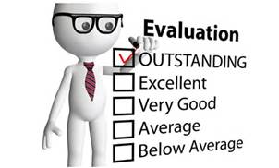
FINAL THOUGHTS
Avoid Common Errors
Spelling
Grammar
Sentence structure
Paragraph formations
Run-on sentences
Lack of focus or thought
Failing to follow directions
Over-use of ‘personal phrases or statements’
e.g. SLANG terms

Slide 43


FINAL THOUGHTS
Turn in your work – BEFORE or by the deadline
Ensure papers are turned in as a PDF
PROOFREAD your paper
Have others proofread your work
FOLLOW the DIRECTIONS!

Slide 44


QUESTIONS ?
Contact Information:
Chief Jeffrey K. Scott
Email: jscott@ndc.edu
Cell: 419-528-8876
Office: 216-373-5407

